Slide 1

Discrete Math Chapter 0
Introduction to Discrete Math

Slide 2
Course Overall
What’s computer science?
Why learn discrete math?
What’s in this course?
How to best learn discrete math?

Slide 3
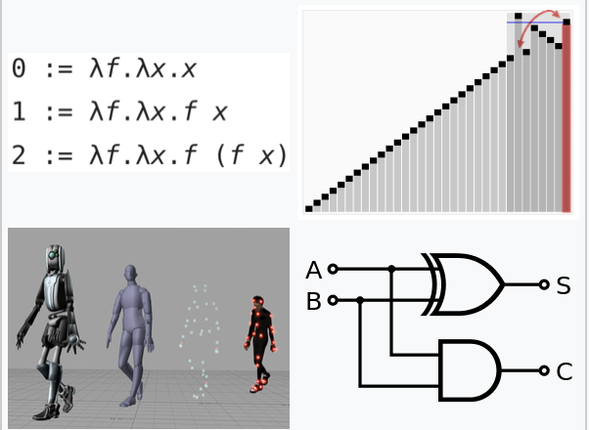
What’s Computer Science?
Computer science is the study of algorithmic processes, computational machines, and computation itself.
Computer science spans a range of topics, from theoretical studies of algorithms, computation, and information to the practical issues of implementing computational systems in hardware and software.
Programming Languages
Computational Complexity
Artificial Intelligence
Computer Architecture
Notes:
\

Slide 4
What’s Computer Science?
Computer science is not only about computers than astronomy is not only about telescopes. Computer science is also not only about coding. (Coding is just implementing algorithms.)
Some common fields of computer science are:
Automata Theory (Computational Theory), Formal Languages, Computational Complexity Theory, Quantum Computing, Logical Circuit, Signal Detection, Encoding, Algorithm Design, Data Structures, Combinatorial optimization, Programming Languages, Machine Learning, Deep Learning, Computer Architectures.

Slide 5
Why Learn Discrete Math?
Discrete math provides a foundation of mathematics for all fields in computer science. Without understanding discrete math, all fields of computer science would be hard to learn.
This course will be helpful for those who are planning to learn algorithms and data structures.

Slide 6
What’s in This Course?
Formal Logics
Proofs
Recusion and Recursive Algorithm
Sets and Probability
Relations and Functions
Graphs and Trees
Graphs and Trees Algorithms
Boolean Algebra

Slide 7
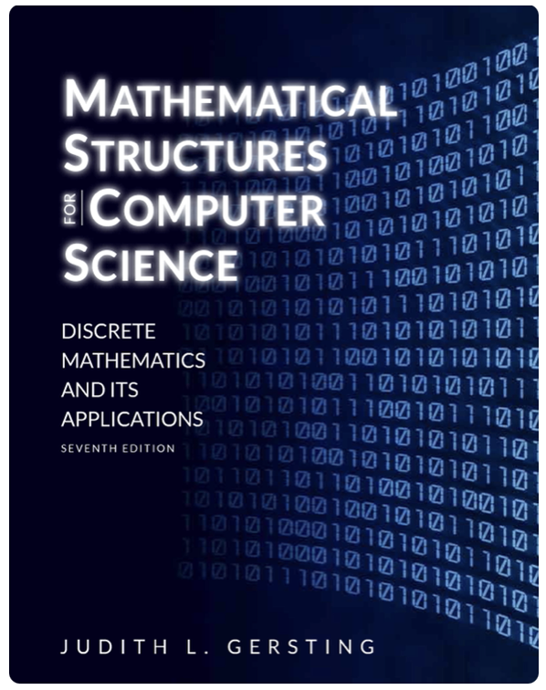
How to Best Learn Discrete Math?
Discrete math is math!! Therefore, do not just watch the videos. Take notes and do exercises.
Ask questions. Use the QA section to ask for help. If your question is associated to a video, mark the timeline so that I can find your problem as soon as possible.
Read the textbook. The textbook is optional for this course, but you can always read the details of discrete math concepts and do more exercises from the book.

